Slide 1


LOCKDOWN

Slide 2
Please read this before you start your workout!
For many remote learning google classroom PE lessons the PE Dept will be setting some physical based challenges. These will be a mixture of youtube training videos, as well as fitness tests and challenges. The aim of these sessions is to improve your personal fitness levels, and keep you active and healthy.
These challenges are physical and will require you to be sensible and thoughtful when completing them. Please consider your clothing, the equipment you are using and the area in which you are exercising.
If you are sick or suffering from an injury please explain this to your PE teacher in the class comments section.
Please give every lesson your best, as you would in your PE lessons in school. As always in PE we value integrity and sportsmanship, so be honest with the results of your workout or fitness challenge. Strive to beat your personal best, and achieve greatness. Your PE teacher will be awarding achievement points for those who are clearly working hard.
Good luck and have fun!

Slide 3
THE LOCKDOWN GAMES- HOW TO PLAY?
The Lockdown Games have been designed to test your accuracy, balance, coordination and skill level across 6 different challenges.
Each challenge is categorised into either “Challenger” or “Legendary”. In the true spirit of the lockdown games, we want everyone to complete both levels of the challenge, in particular, the Legendary option!
You can complete each challenge a maximum of three times with your best score going forward. Record this on your tracker
Each challenge contains an equipment list and alternative items….should you not have the equipment to hand.
Good luck, embrace the challenge and seize immortality!

Slide 4
Equipment List
The equipment list below details to you everything you need to equip yourself to take on the lockdown games. Anything in the “Essential” column, you must have to take part. The items in the “Substitute” column can act as replacements for items you may not have.
Essential | Substitute
Water Bottle
Toilet Roll (x1) | Tennis Ball/Orange
2 Tins | 2 bottles/2 shoes
Mug | Bowl
Tea Bags | Scrunched up paper
1 small tea towel | Hand towel or sheet of A4 paper
Timer/Smart phone | Count out loud
Gather all of the equipment before starting

Slide 5


Challenge 1- Total Teabags
Challenger Status
3 large steps away from target (3-4m away)
Face towards target
5 attempts at landing as many tea bags in the mug as possible (or rolled up paper)
Legendary Status
3 large steps away from target (3-4m away)
Turn around to face opposite direction
5 attempts at landing as many tea bags in the mug as possible (or rolled up paper)
Can you beat Mr Naylor’s score of…..0 (probably)

Slide 6


Challenge 2- Bottle Flip
Challenger Status
Stand next to a raised surface, one step away (arms distance)
Attempt to flip the bottle in one full rotation and land flat on the surface.
Your score is how many times you can land the bottle in a row without it falling over
Legendary Status
Stand next to a raised surface, three pigeon steps away
Attempt to flip the bottle in one full rotation and land flat on the surface.
Your score is how many times you can land the bottle in a row without it falling over
Can you beat Mr Naylor’s score of 4?

Slide 7
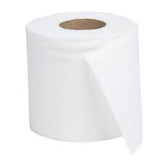

Challenge 3- Toilet Roll Catch
Challenger Status
Hold the toilet roll in two hands.
Throw up in the air, rotate 180 degrees and catch it behind your back
Your score is how many times you catch the toilet roll in a row without it hitting the floor.
Legendary Status
Hold the toilet roll in two hands.
Throw up in the air and catch it behind your back whilst facing the same direction
Your score is how many times you catch the toilet roll in a row without it hitting the floor.
Can you beat Mr Naylor’s score of 4?

Slide 8
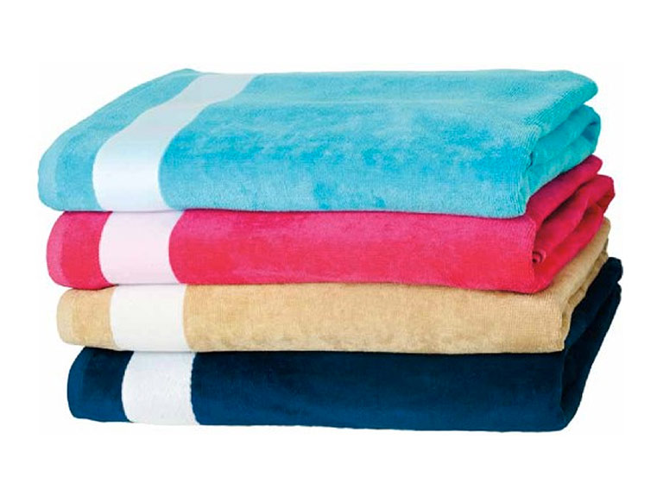

Challenge 4- Target roll
Challenger Status
Fold a tea towel (small towel or piece of A4 paper) in half
Take three large steps away from the target. (4-5m)
Roll the toilet roll and attempt to land it on the target
Your score is determined by how fewer attempts it takes, first time is the best possible score!
Legendary Status
Fold a tea towel (small towel or piece of A4 paper) in half and then half again
Take three large steps away from the target. (4-5m)
Roll the toilet roll and attempt to land it on the target
Your score is determined by how fewer attempts it takes, first time is the best possible score!
Can you equal Mr Naylor’s perfect score on legendary?

Slide 9
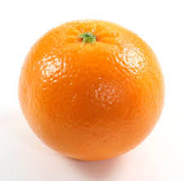
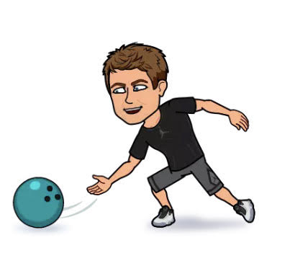
Challenge 5- SOUPerbowl
Challenger Status
Position two tins (or any other item) 2 hand widths apart at a distance of 4-5m away.
Using an orange (tennis ball or toilet roll) attempt to roll the item through the gate.
The highest score is the most amount of successful rolls in 30 seconds.
Legendary Status
Position two tins (or any other item) 1 hand width apart at a distance of 4-5m away.
Using an orange (tennis ball or toilet roll) attempt to roll the item through the gate.
The highest score is the most amount of successful rolls in 30 seconds.

Slide 10

Challenge 6- Balance the bogroll
Challenger Status
Position a toilet roll on the top of your head.
Whilst keeping the toilet roll steady, move down towards the ground ensuring you are in the press up position.
Return to standing position.
Using a timer, complete this as quickly as possible.
Legendary Status
Position a toilet roll on your forehead
Whilst keeping the toilet roll steady, move down towards the ground ensuring your back is in contact with the floor.
Return to standing position.
Using a timer, complete this as quickly as possible.
Can you beat Mr Naylor by not dropping the toilet roll?

Slide 11
THE LOCKDOWN GAMES- COMPLETE?
If you are viewing this slide, then you have most likely completed the rigorous 6 challenges posed for you today. Can you check you have done the following;
Completed all six challenges on Challenger and Legendary
Recorded your scores on THE LOCKDOWN GAMES TRACKER
Handed your work in so your teacher can review your scores and let you know whether your efforts have qualified for an achievement point (or 2)!
If you have finished the lesson earlier than expected;
Email your class teacher with an adaptation to an existing challenge or new idea for a challenge that you would like to complete.

Slide 12
Mission accomplished!

